Slide 1
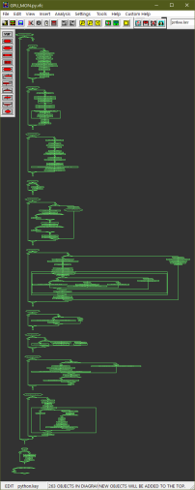
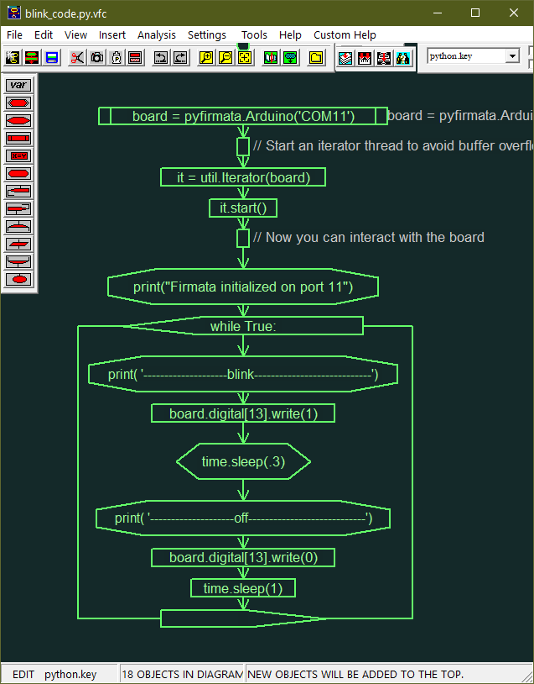
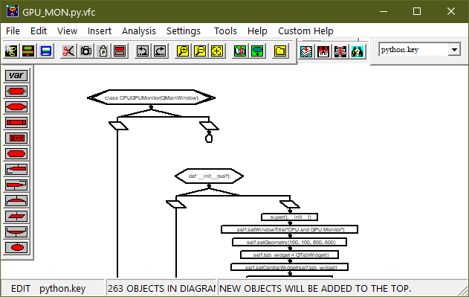
Visual Flow Code Workshop
Introducing
VFcode

Slide 2
The Developer's Dilemma
58% of development time spent on program comprehension activities Source: IEEE Transactions on Software Engineering, 2018
Complex nested logic can lie buried in syntax variations
AI generates code but lacks structural understanding
Legacy code requires an archaeological expedition for months to decipher
Knowledge gets trapped in language-specific syntax patterns
IDEA: Why not make the same logic structure look similar regardless of code language?

Slide 3
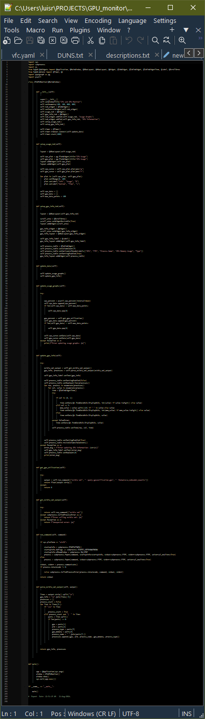
What if Code Could Draw Itself?
← VFC Parsers
def setup_usage_tab(self):
layout = QVBoxLayout(self.usage_tab)
self.cpu_plot = pg.PlotWidget(title="CPU Usage")
self.gpu_plot = pg.PlotWidget(title="GPU Usage")
layout.addWidget(self.cpu_plot)
def update_data(self):
layout.addWidget(self.gpu_plot)
def setup_gpu_info_tab(self):
self.cpu_curve = self.cpu_plot.plot(pen="g")
self.gpu_curve = self.gpu_plot.plot(pen="r")
layout = QVBoxLayout(self.gpu_info_tab)
self.update_usage_graphs()
for plot in [self.cpu_plot, self.gpu_plot]:
scroll_area = QScrollArea()
self.update_gpu_info()
plot.setYRange(0, 100)
scroll_area.setWidgetResizable(True)
plot.setLabel("left", "Usage", "%")
layout.addWidget(scroll_area)
plot.setLabel("bottom", "Time", "s")
gpu_info_widget = QWidget()
self.cpu_data = []
scroll_area.setWidget(gpu_info_widget)
self.gpu_data = []
gpu_info_layout = QVBoxLayout(gpu_info_widget)
self.max_data_points = 100
self.tab_widget.addTab(self.usage_tab, "Usage Graphs")
self.gpu_info_label = QLabel()
self.tab_widget.addTab(self.gpu_info_tab, "GPU Information")
gpu_info_layout.addWidget(self.gpu_info_label)
def main():
self.process_table = QTableWidget()
self.process_table.setColumnCount(5)
self.process_table.setSortingEnabled(True)
gpu_info_layout.addWidget(self.process_table)
app = QApplication(sys.argv)
def get_gpu_utilization(self):
window = CPUGPUMonitor()
try:
window.show()
except:
sys.exit(app.exec())
output = self.run_command(["nvidia-smi", "--query-gpu=utilization.gpu", "--format=csv,noheader,nounits"])
return float(output.strip())
return 0
def __init__(self):
super().__init__()
if __name__ == "__main__":
self.setWindowTitle("CPU and GPU Monitor")
self.setGeometry(100, 100, 800, 600)
self.tab_widget = QTabWidget()
main()
self.setCentralWidget(self.tab_widget)
self.usage_tab = QWidget()
def get_nvidia_smi_output(self):
self.gpu_info_tab = QWidget()
self.setup_usage_tab()
self.setup_gpu_info_tab()
self.timer = QTimer()
try:
self.timer.timeout.connect(self.update_data)
return self.run_command(["nvidia-smi"])
except subprocess.CalledProcessError as e:
except Exception as e:
self.timer.start(1000)
def update_usage_graphs(self):
return f"Error calling nvidia-smi: {e}"
return f"Unexpected error: {e}"
try:
except Exception as e:
cpu_percent = psutil.cpu_percent(interval=None)
self.cpu_data.append(cpu_percent)
self.cpu_data.pop(0)
if len(self.cpu_data) > self.max_data_points:
def parse_nvidia_smi_output(self, output):
gpu_percent = self.get_gpu_utilization()
lines = output.strip().split("\n")
self.gpu_data.append(gpu_percent)
gpu_info = "\n".join(lines[:3])
if len(self.gpu_data) > self.max_data_points:
processes = []
self.gpu_data.pop(0)
process_start = False
for line in lines[3:]:
process_start = True
if "|==" in line:
elif process_start and "| " in line:
self.cpu_curve.setData(self.cpu_data)
parts = line.split()
self.gpu_curve.setData(self.gpu_data)
gpu = parts[1]
if len(parts) >= 8:
pid = parts[4]
process_type = parts[5]
gpu_memory = parts[6]
process_name = " ".join(parts[7:])
processes.append([gpu, pid, process_name, gpu_memory, process_type])
return gpu_info, processes
Reveals the Code’s Underlining Structure: “Code DNA”

Slide 4
12 “Universal” Tokens
VFC’s Building Blocks
input() / end() → Function boundaries
branch()/path()/bend() → Conditional logic
loop() / lend() → Iteration
set() → Variable assignment
process() → Function calls
output() → Display/print
event() → Imports/includes
generic() → Anything

Slide 5
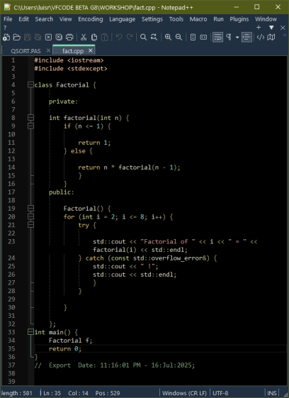
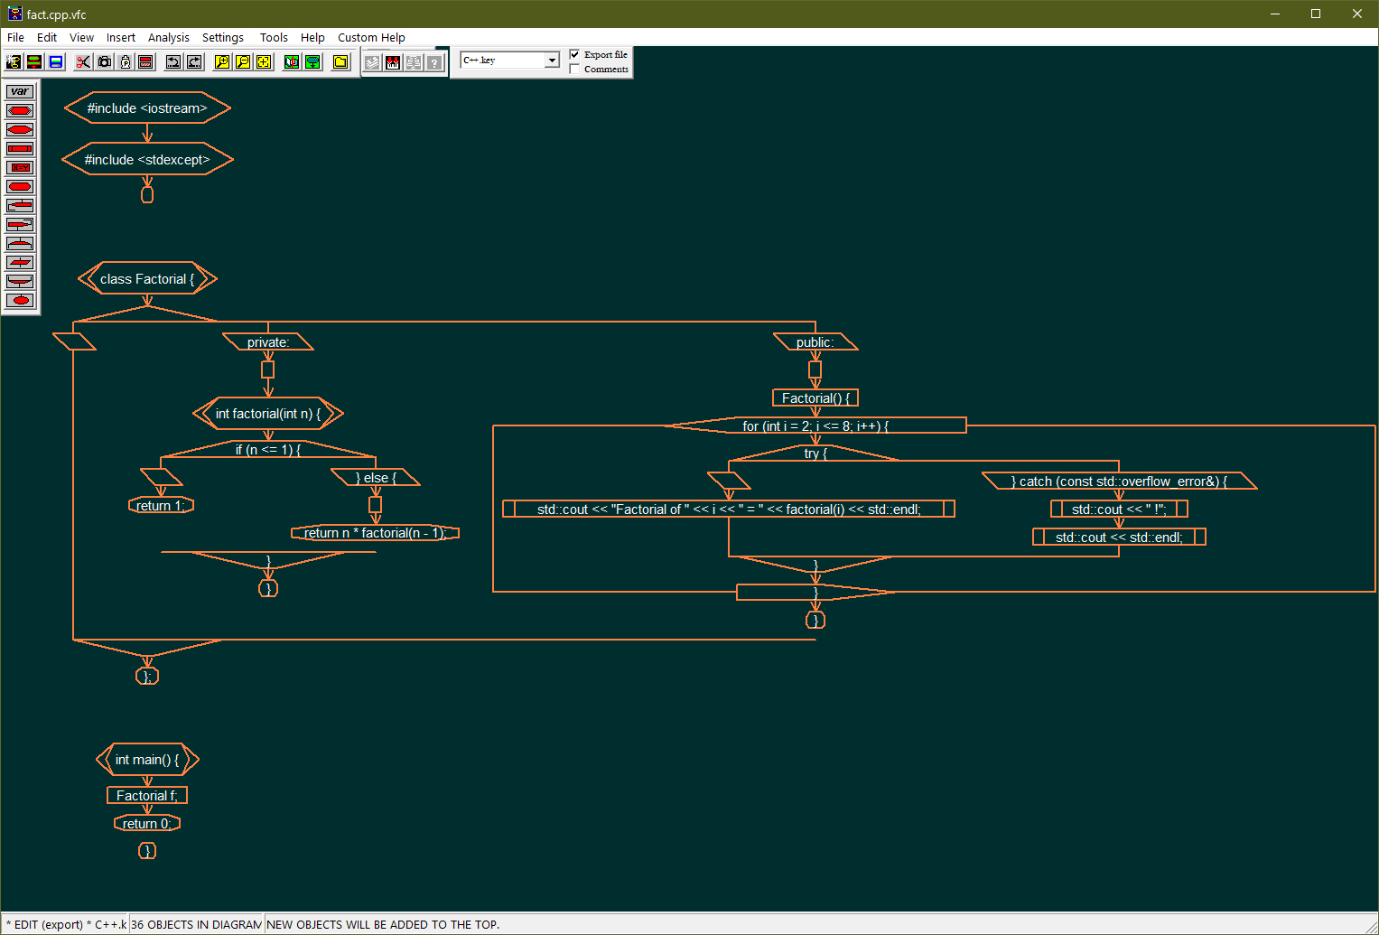
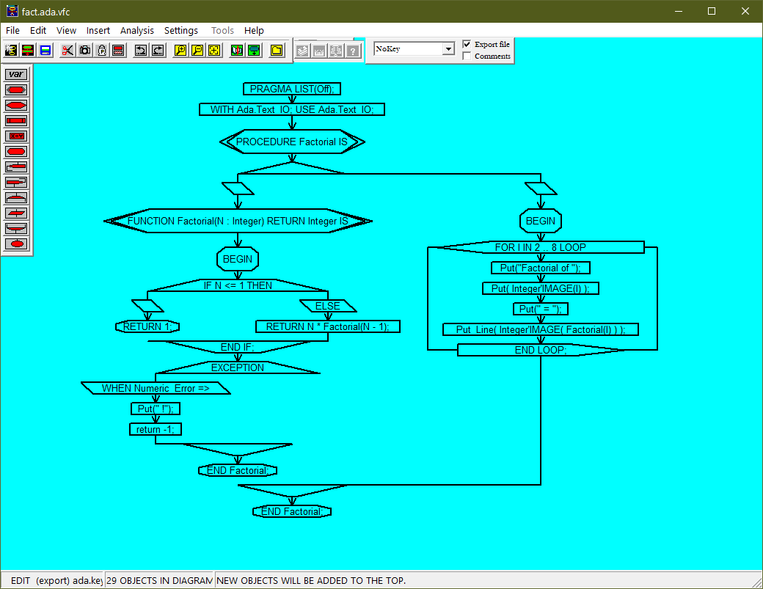
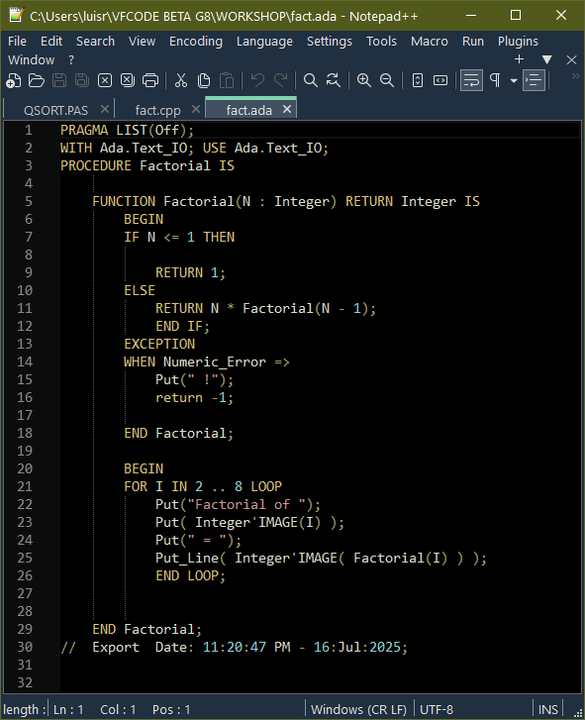
Same Algorithm, Different Clothes

Slide 6
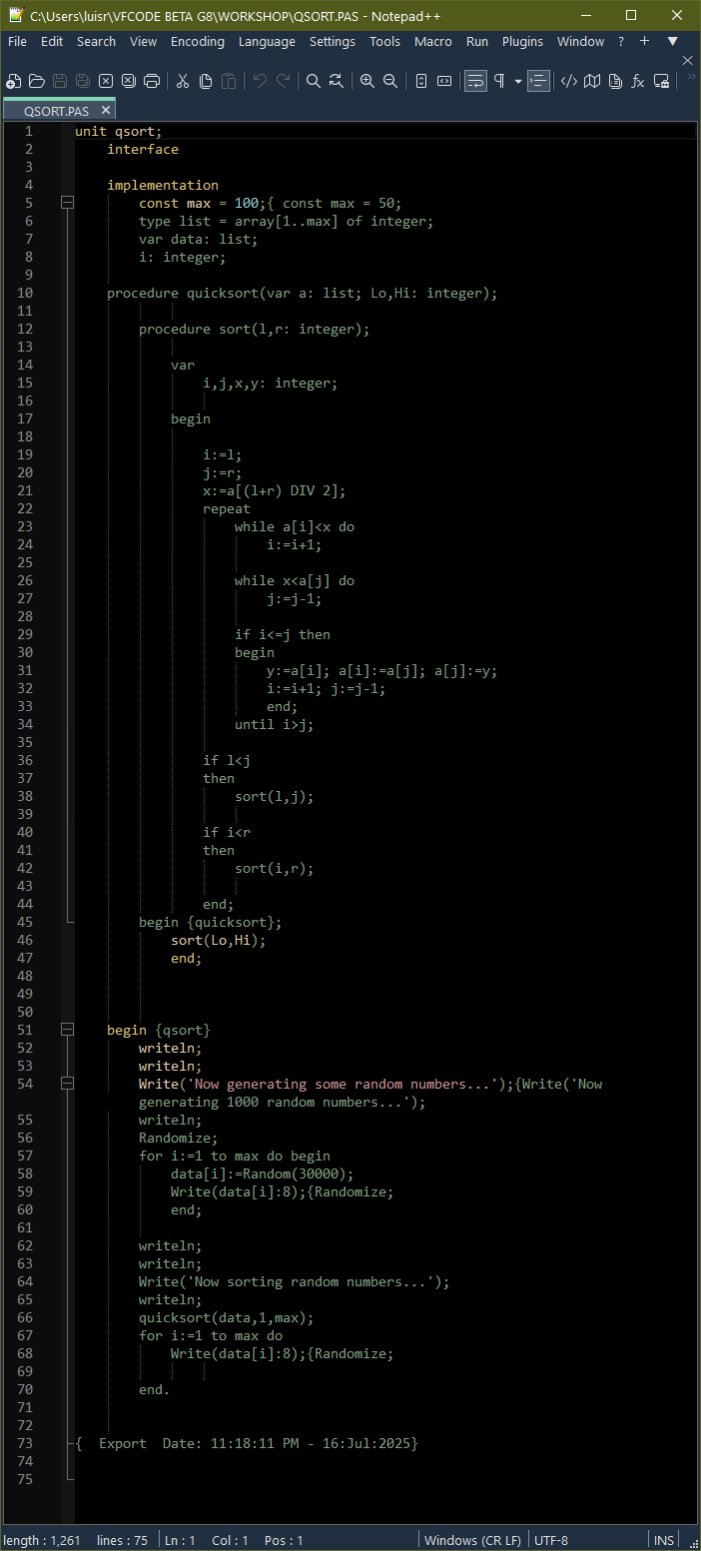
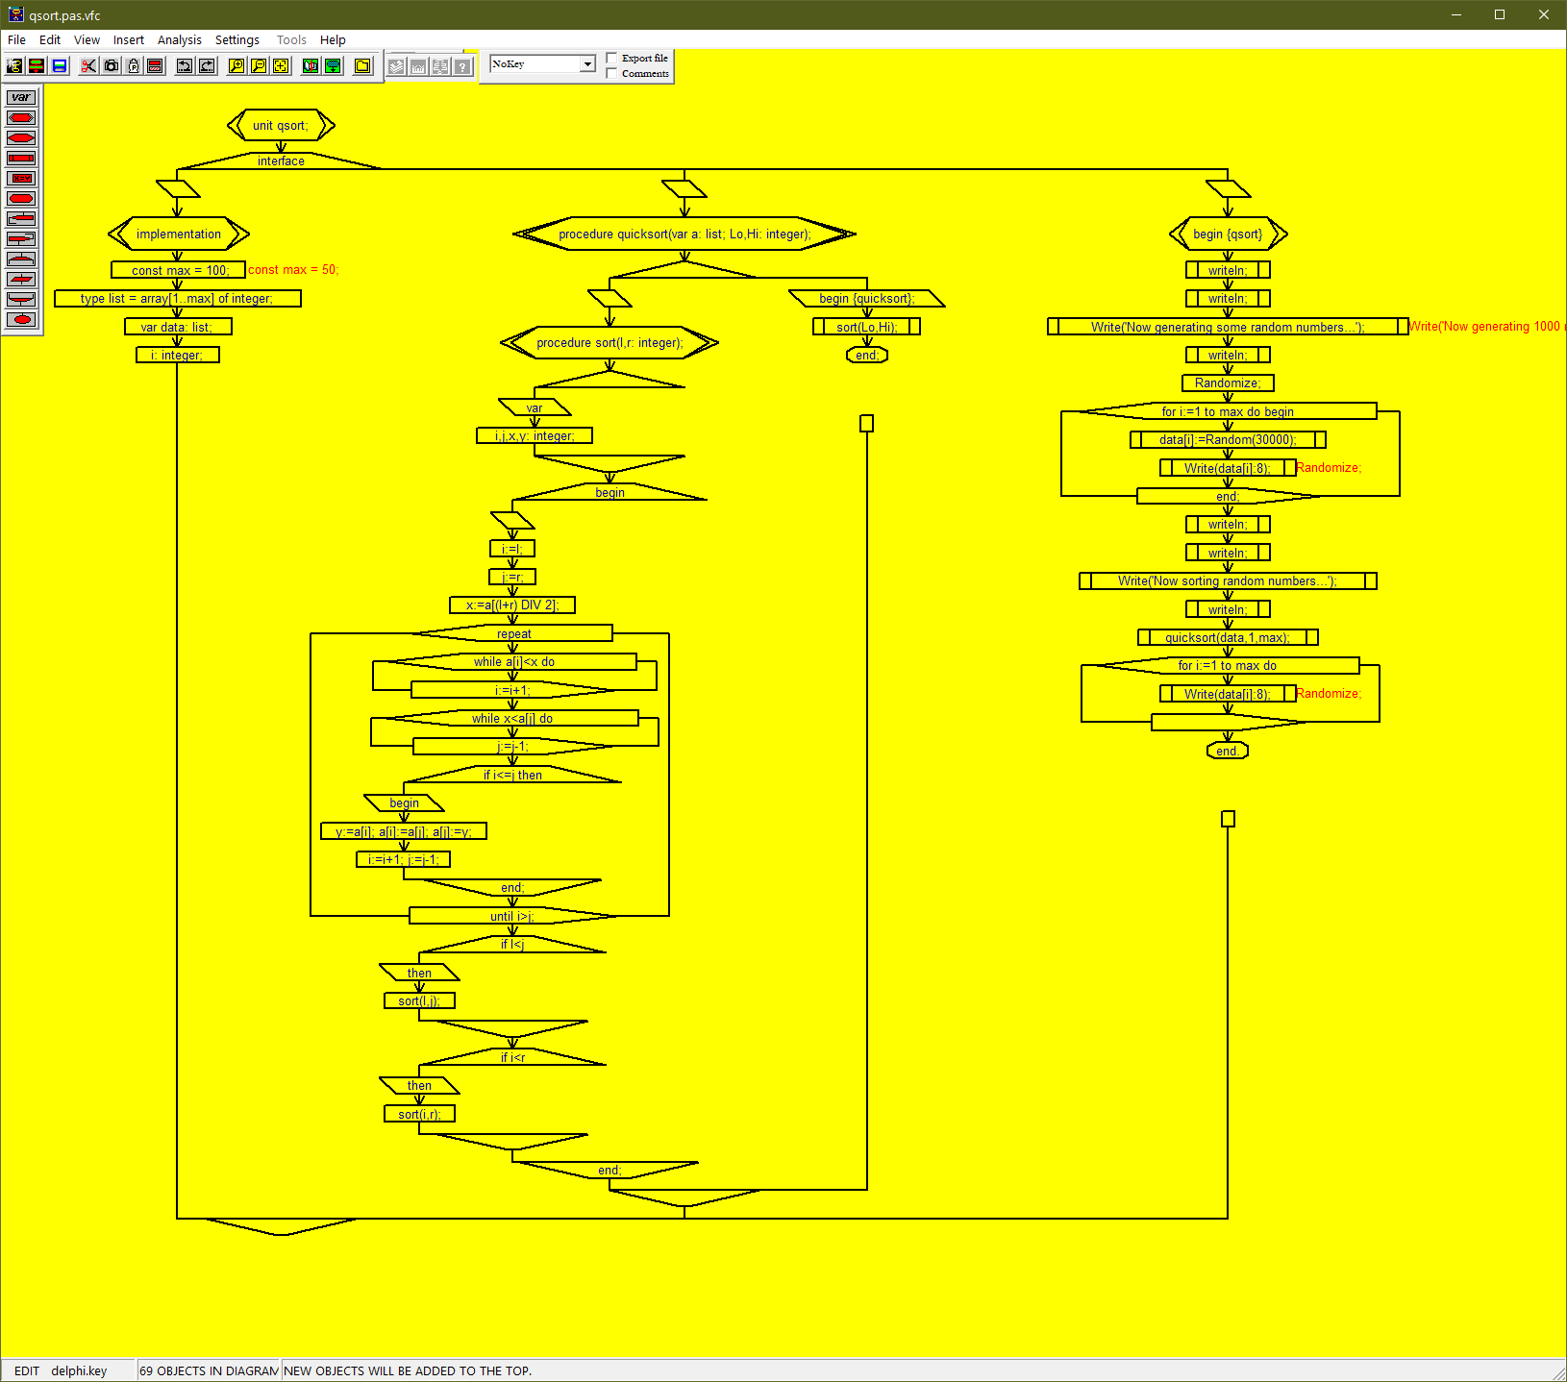
Pascal

Slide 7
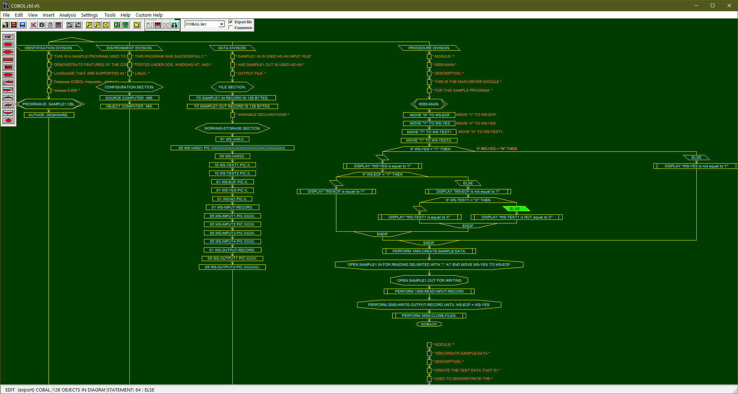
COBOL

Slide 8
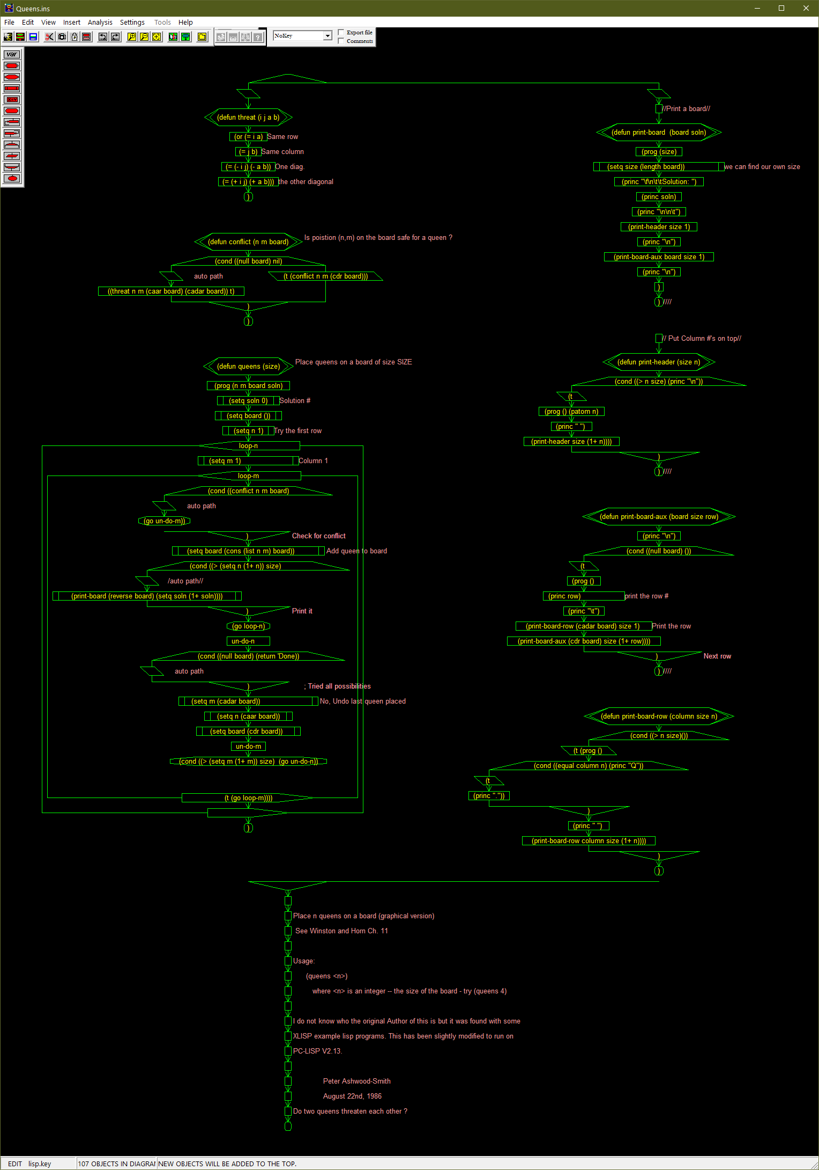
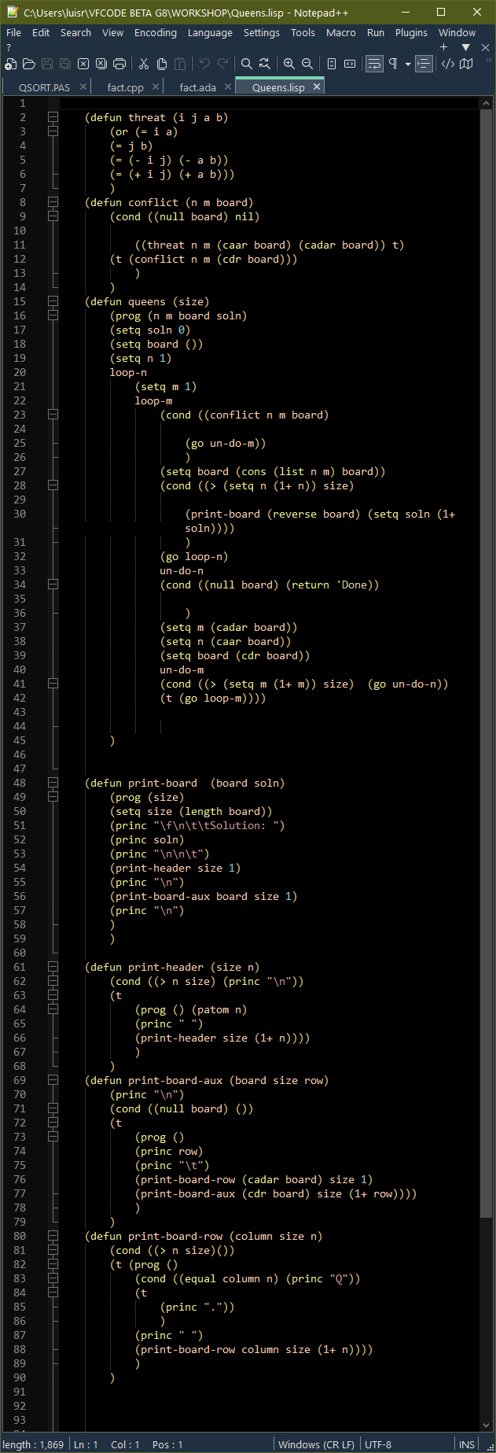
Lisp

Slide 9
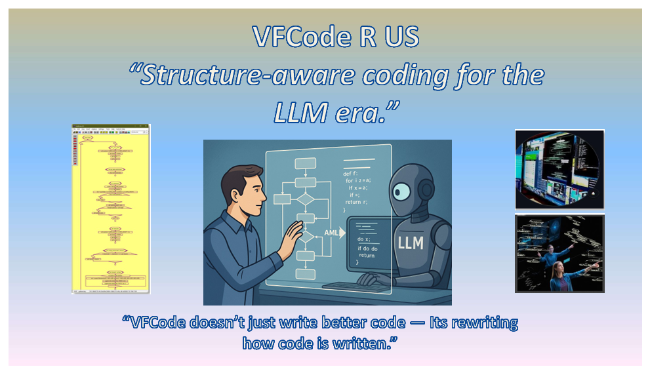
Visual Revelation:
Common Structure helps LLMs and PPL make better software

Slide 10
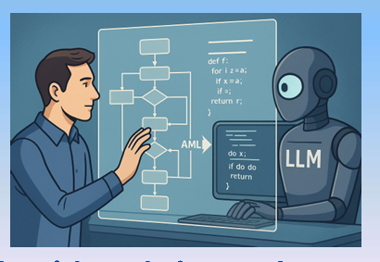
AI-Human Perfect Partnership : AI does Syntax – Human Architect Structure
For LLMs:
Better pattern recognition and accuracy
Improved context understanding
Eliminates organizational guesswork
For Humans:
Faster code comprehension
Easier error detection
Reduced cognitive overhead
For Collaboration:
Shared vocabulary and references
Predictable code generation
Precise iterative improvements
Result: A "shared language" facilitates efficient, error-free collaboration

Slide 11
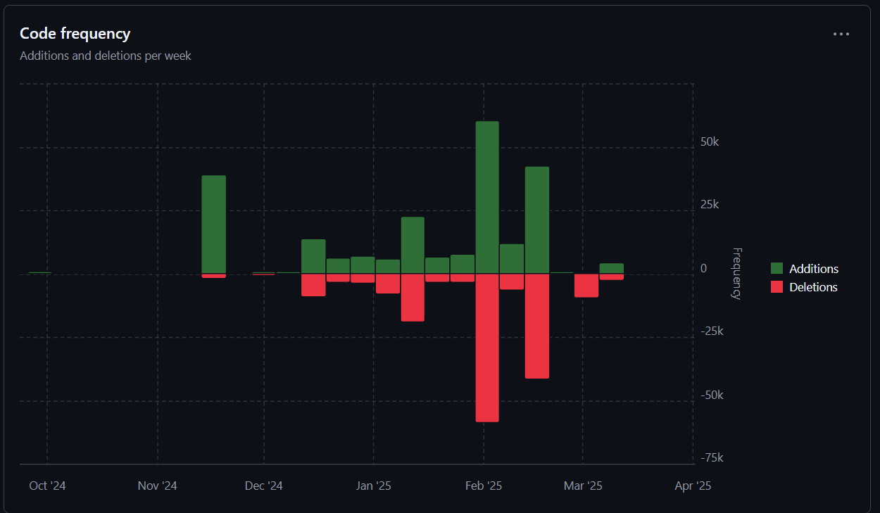


The Superhuman Developers Break all Language Barriers

Slide 12
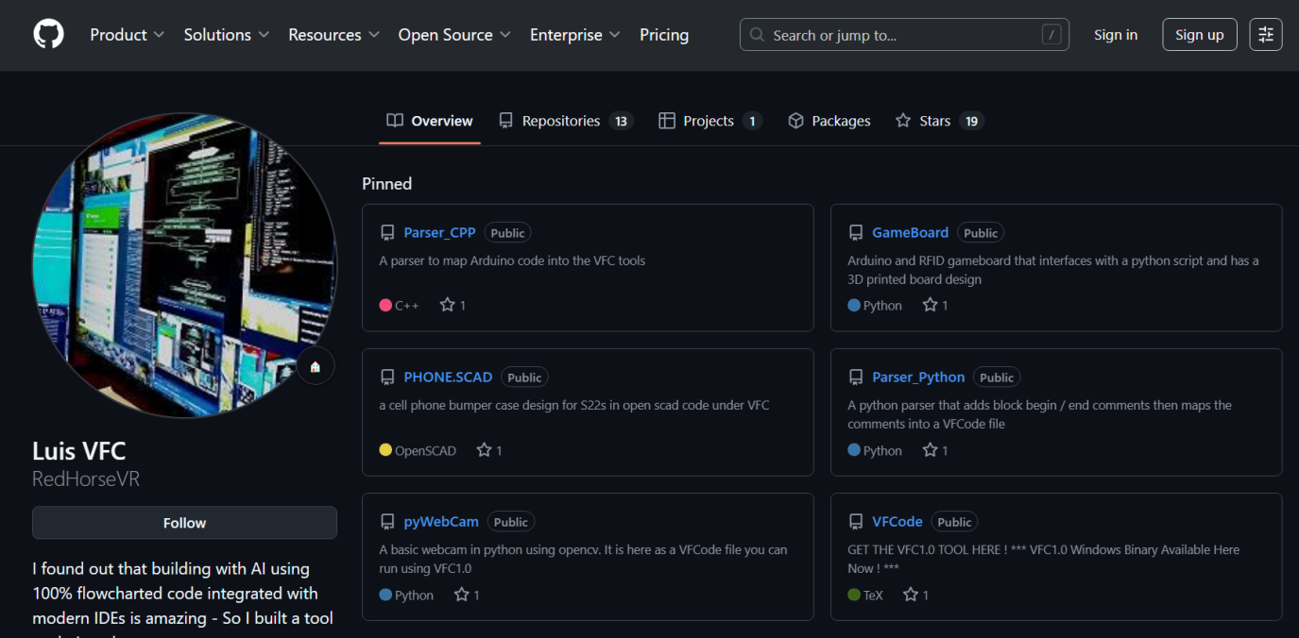
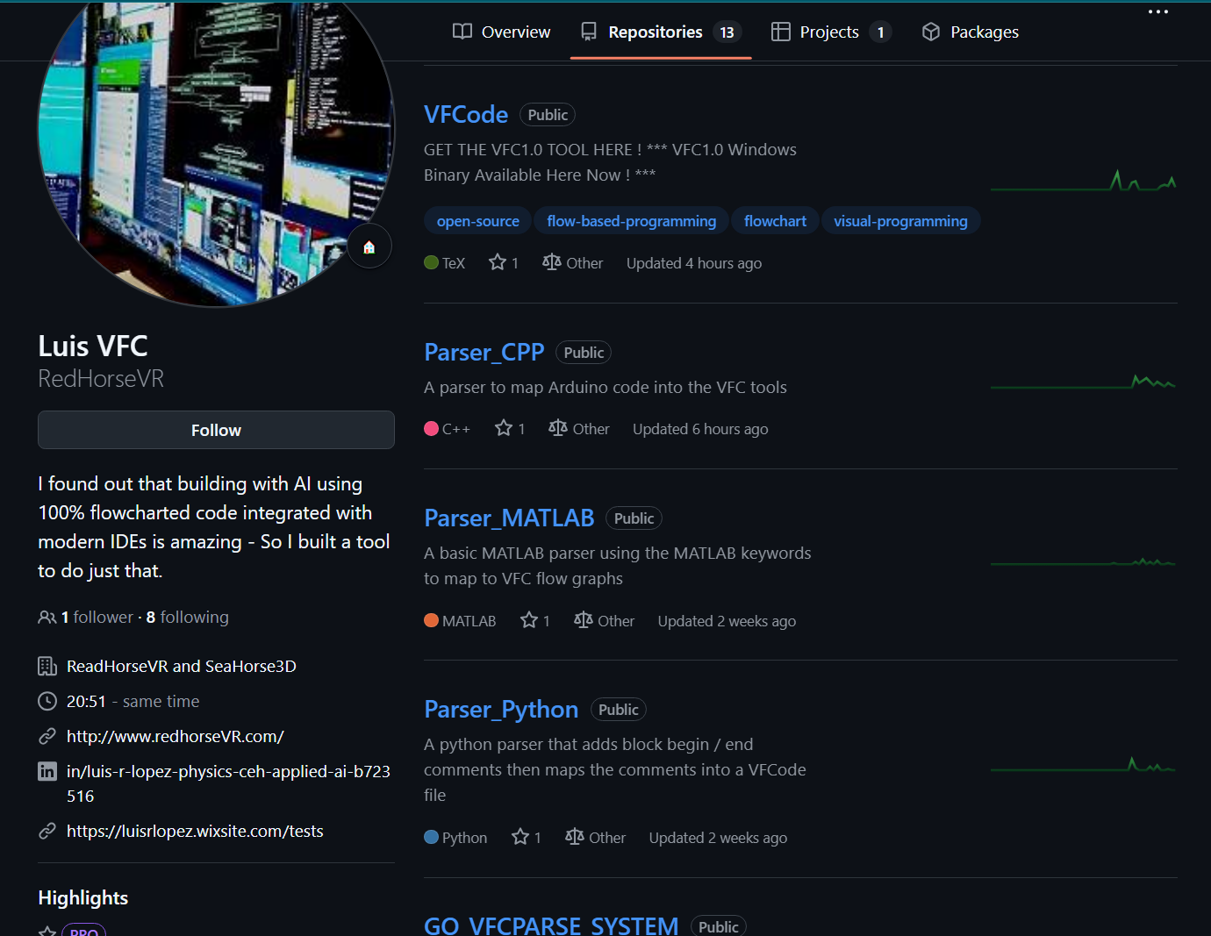

Getting Started Today Your VFC Journey
Binary here, Email for src access
VFcode

